Slide 1
Working with Windows Form Controls
- By Nimesh Kumar Dagur

Slide 2
Introduction
A control is a component or tool of .NET Framework, which is used to take input from the user and to display some information to the user.
In other words, a control is used to facilitate interaction between the user and the application.
Each control contains certain properties, methods and events defined to make it suitable to perform a particular action.
The controls used to create Windows Forms applications are commonly referred to as Windows controls.
There are several Windows controls that Visual C# provides to accept input and display output to the user.
These controls are available in the Toolbox of Visual Studio Integrated Development Environment (IDE).

Slide 3
Windows Form controls
Most commonly used Windows controls:
Label control,
TextBox control,
Button control,
RadioButton control,
CheckBox control,
ComboBox control,
ListBox control,
GroupBox control,
Panel control,
PictureBox ,
Timer control, and
ProgressBar control

Slide 4
The Control Class
The Control class is the base class for all Windows controls.
The Control class belongs to the System.Windows.Forms namespace.
The Control class is derived from the Component class, which is further derived from the MarshalByRefObject class.
The Object class is the base class of all the aforementioned classes, such as Control, Component, and MarshalByRefObject.
System.Object
System.MarshalByRefObject
System.ComponentModel.Component
System.Windows.Forms.control
System.Windows.Forms.Form

Slide 5
The Control Class
All Windows controls are based on the Control class; they inherit many common properties, methods, and events from the Control class.
The Form class is also derived from the Control class. Therefore, it also shares all these properties, methods, and events.

Slide 6
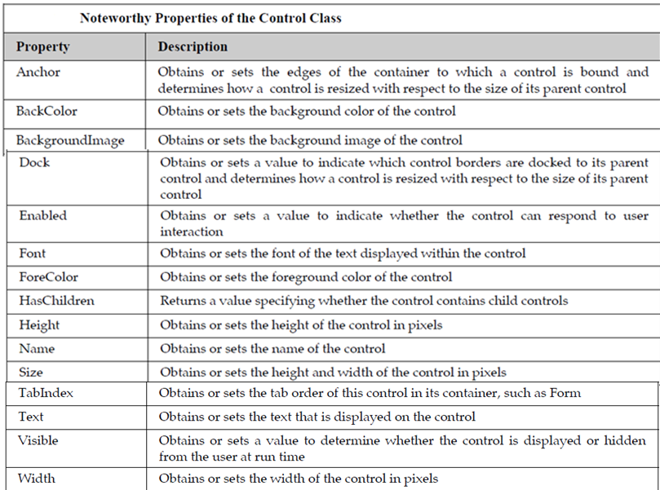

Slide 7
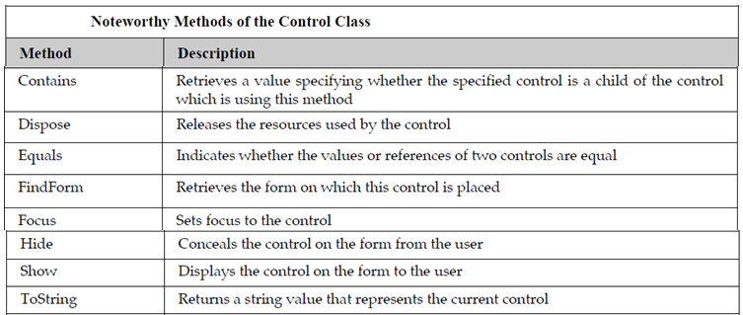

Slide 8
Developing a Windows forms Application
Windows Forms provide your project with components, such as dialog boxes, menus, buttons, and many other controls, that make up a standard Windows application user interface (UI).
Fundamentally, these controls are just classes from the .NET Framework class library.
The Designer view in Visual Studio enables you to drag the controls onto your application's main form and adjust their size and position.
As you do this, the IDE automatically adds the source code to create an instance of the appropriate class and initialize it.

Slide 9
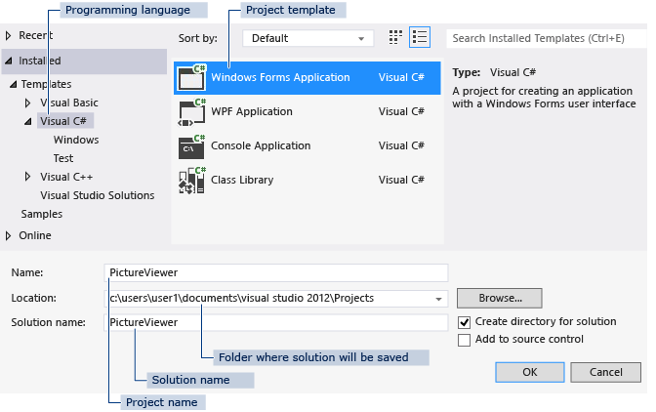

Slide 10
